Slide 1
Project Presentation of CO-OP Project at Industry (Module-2) (22CS421)
On
Implementing AI-Driven Cybersecurity
Himanshi Aggarwal(2210991655)
Gurpreet Kaur(2210991597)
Kashish Mahana(2210990497)
Supervised By
Swati Goel
Department of Computer Science and Engineering,
Chitkara University, Punjab

Slide 2

Introduction
The Need for Intelligent Systems
Traditional signature-based defenses are failing against Zero-Day exploits and polymorphic malware.
Sophisticated socially engineered phishing campaigns now evade rule-based filters with ease.
There is an urgent need for adaptive, real-time security that detects threats without pre-defined signatures.
2

Slide 3
Core AI Techniques
Leveraging the diverse toolkit of Artificial Intelligence to transform the defence landscape.

Slide 4
AI Methods in CyberSec
Machine Learning
Supervised algorithms, such as Random Forest, learn discriminative features to classify network traffic and sessions.
Deep Learning
DNNs and CNNs enable the automatic extraction of features from raw binary data, thereby bypassing the need for manual engineering.
NLP
Understanding unstructured text via BERT to detect social engineering patterns in phishing emails.

Slide 5
Threat Detection Pipeline
Data Collection
Ingesting network packet captures and endpoint logs.
Preprocessing
Normalisation and automated feature extraction.
AI Inference
ML/DL models output classification and confidence.
Response
Automated IP blocking or session quarantine.
5

Slide 6
Primary Detection Algorithms
Real-Time Detection
Uses Random Forest and LSTM on the NSL-KDD dataset. Integrates deviation scoring to identify behavioural anomalies.
Phishing Analysis
Combines BERT embeddings with lexical features (urgency, domain spoofing). Analyses body content and URL entropy.

Slide 7
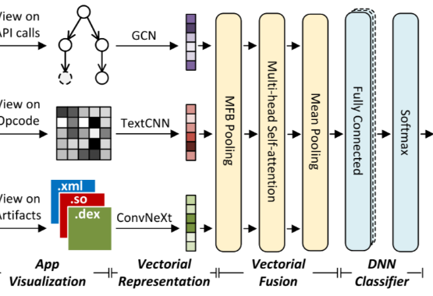
Deep Learning Malware Analysis
Algorithm 3: Multi-Layer DNN
Static Features: PE headers, file entropy, and imported APIs.
Dynamic Analysis: Sandbox syscall sequences and memory access.
Classification: Categorises into 7 malware families (Virus, Trojan, Ransomware, etc).
Performance: Achieved 95.2% accuracy and 96.1% precision.

Slide 8
Unsupervised Anomaly Detection
93%
Reconstruction Confidence
Algorithm 4: Autoencoders
Trained exclusively on benign traffic to learn a compressed representation of normal behaviour.
High reconstruction error signals malicious inputs, effectively detecting Novel Attacks with no known signature.
Separates the signal of normal operation from the noise of zero-day exploits."

Slide 9
Detection Performance Metrics
Threat Type | Accuracy | Precision | Recall | F1-Score
Malware Detection | 95.2% | 96.1% | 94.8% | 0.951
Phishing Detection | 91.4% | 93.0% | 90.5% | 0.918
Anomaly / Intrusion | 87.6% | 89.2% | 86.1% | 0.878
Fraud Detection | 93.1% | 94.7% | 91.9% | 0.935

Slide 10
Key Challenges & Risks
Adversarial Attacks: Input perturbations can reduce malware classifier accuracy from 95% to below 60%.
Data Privacy: GDPR constraints limit the collection of large-scale organisational traffic data.
Bias: Models trained on specific datasets may have blind spots for different regions or device types.
Explainability (XAI): Black-box models remain challenging to audit in regulated sectors, such as banking.

Slide 11
Conclusion & Future Work
Implementation of Federated Learning for privacy.
Lightweight architectures for IoT Edge security
Integrating SHAP/LIME for model transparency.
Cross-domain threat correlation frameworks.
Any Questions?
Contact: gurpreet1597.be22@chitkara.edu.in

